Slide 1
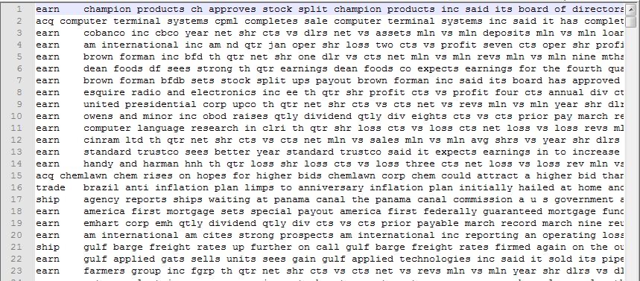
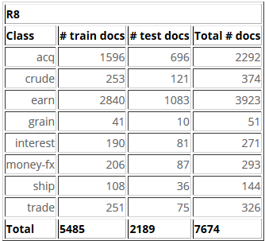
Reuters-21578 subset(R8)
8 classes, 5485 docs for training, 2189 docs for test

Slide 2
Reuters-21578 subset(R8)
Class name
Document body
‘\t’ (tab)

